Slide 1

Multi-Platform Product Review Sentiment Analyzer
Project Guide
Prof.Richa Singh
Student ID | Group Member
Chitresh Poojary | 22107010
Gaurav Shetty | 23107127
Shlok Sawant | 23107142
Manish Sharma | 23107058
Notes:
‹#›

Slide 2
Outline
Introduction
Literature Survey of the existing systems
Limitations of the existing systems
Problem statement
System Design
Technologies and methodologies
Implementation
Conclusion
References
Notes:
‹#›

Slide 3
Introduction
The rapid growth of e-commerce platforms has significantly changed the way people purchase products. Websites such as Amazon, Flipkart, and other online marketplaces allow customers to share their experiences through product reviews and ratings. These reviews play an important role in influencing the purchasing decisions of other customers. However, since reviews are spread across multiple platforms and are available in large numbers, it becomes difficult for users to read and analyze all of them to understand the overall opinion about a product.
To address this problem, sentiment analysis, a technique of Natural Language Processing (NLP), can be used to automatically analyze and classify reviews into positive, negative, or neutral sentiments. The proposed system, Multi-Platform Product Review Sentiment Analyzer, aims to collect product reviews from different e-commerce platforms and analyze their sentiments. The system will also identify the most positive and most negative reviews and display the insights using an interactive dashboard. This will help users quickly understand customer opinions and make more informed purchasing decisions.

Slide 4
Introduction
Objective:
To collect product reviews from multiple e-commerce platforms such as Amazon, Flipkart, etc., for a single product.
To identify and extract the best (most positive) and worst (most negative) reviews for each product.
To visualize sentiment distribution, ratings, and review insights using an interactive dashboard.
To help users make informed purchasing decisions by providing a consolidated sentiment summary.
Notes:
‹#›

Slide 5
Literature Survey of the existing system
Sr. no | Title | Author(s) | Year | Outcome | Methodology | Result
1. | [1] Sentiment Analysis for Product Reviews | Anil B., Aman Kumar Singh, Aditya Kumar Singh, Surekha Thota | 2019 | Helps analyze large volumes of product reviews and determine sentiment polarity. | Used NLP techniques and VADER sentiment analysis on reviews collected from Amazon, Flipkart, and Snapdeal. | Demonstrated that sentiment analysis can efficiently classify customer opinions into positive, negative, and neutral sentiments.
2. | [2] Sentiment Analysis based Method for Amazon Product Reviews | Jyoti Budhwar, Sukhdip Singh | 2021 | Extracts useful insights from product reviews to help users understand customer feedback | Collected Amazon reviews and applied NLP preprocessing, tokenization, and sentiment classification to determine positive and negative opinions. | The system successfully classified reviews into sentiment categories and improved understanding of customer opinions.
Notes:
‹#›

Slide 6
Literature Survey of the existing system
Sr. no | Title | Author(s) | Year | Outcome | Methodology | Result
3. | [3] Sentiment Analysis of Flipkart Product Reviews using NLP | S. Kiruthika, U. Sneha Dharshini, K. R. Vaishnavi, R. V. Vishwa Priya | 2023 | Understands consumer opinions based on ratings and review text. | Collected Flipkart product reviews and used Natural Language Processing for sentiment classification. | Results showed that sentiment analysis helps identify customer perception and product success factors.
4. | [4]Sentiment Analysis of Online Shopping Platform Product Reviews | Soumyadeep Paul, Soham Bhattacharyya, Jishnu Chakrabort, Nabarun Ray | 2025 | Predicts sentiment polarity of reviews to analyze customer satisfaction levels. | Used machine learning models such as Random Forest and Decision Tree, with preprocessing and review score-based labeling. | Machine learning models effectively categorized reviews and improved sentiment prediction accuracy.
Notes:
‹#›

Slide 7
Limitations of existing systems
Single Platform Analysis:
Most existing sentiment analysis systems focus on reviews from only one e-commerce platform such as Amazon or Flipkart. Because of this, users cannot see a combined analysis of reviews from multiple platforms for the same product.
Difficulty in Handling Large Volume of Reviews:
E-commerce websites contain thousands of reviews for a single product. Existing systems often struggle to efficiently process and analyze such large amounts of textual data in a meaningful way.
Limited Sentiment Accuracy:
Many traditional sentiment analysis methods rely on basic Natural Language Processing techniques. These approaches may not accurately detect sarcasm, mixed opinions, or context in customer reviews.
Notes:
‹#›

Slide 8
Problem statement
Product reviews are available on multiple e-commerce platforms such as Amazon, Flipkart, etc., making it difficult for users to collect and analyze all reviews for a single product.
The large volume of reviews makes it time-consuming for users to read and understand overall customer opinions.
Existing platforms mainly show individual reviews and ratings but do not provide a consolidated sentiment summary.
Users find it difficult to identify the most positive (best) and most negative (worst) reviews quickly.

Slide 9
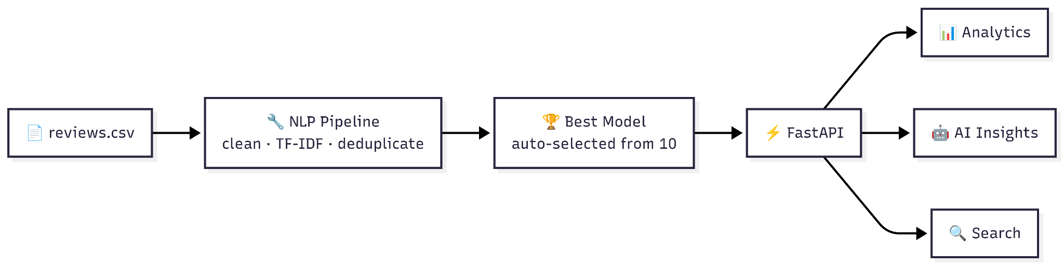
System Design
Notes:
‹#›

Slide 10
Technologies and methodologies
Python – Used as the main programming language for backend development, data processing, and implementing sentiment analysis logic.
FastAPI – Used to build fast and efficient APIs that handle requests, process product reviews, and communicate between the frontend and backend.
NumPy – Used for numerical computations and handling arrays during data processing.
Pandas – Used for data cleaning, data manipulation, and organizing product review datasets for analysis.
Scikit-learn (Sklearn) – Used to implement machine learning algorithms for sentiment classification of product reviews.
OpenRouter (AI Service) – Used to access advanced AI models for natural language processing and sentiment analysis.
HTML – Used to create the structure of the frontend web pages.
CSS – Used to design and style the user interface.
JavaScript – Used to add interactivity and display results such as sentiment insights and dashboards on the frontend.
Notes:
‹#›

Slide 11
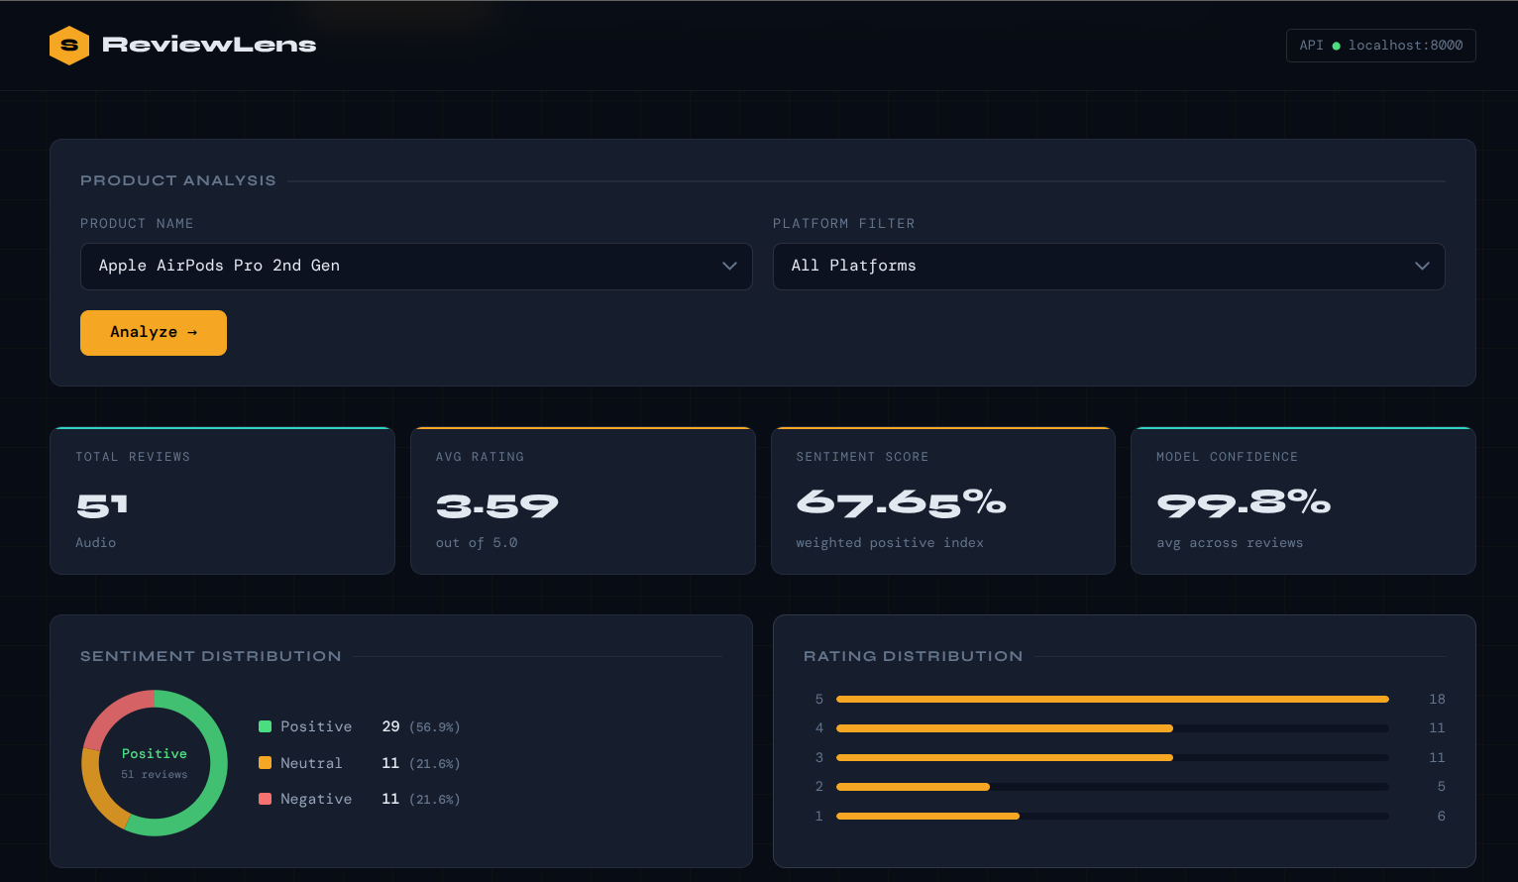
Implementation
Landing Page:
Notes:
‹#›

Slide 12
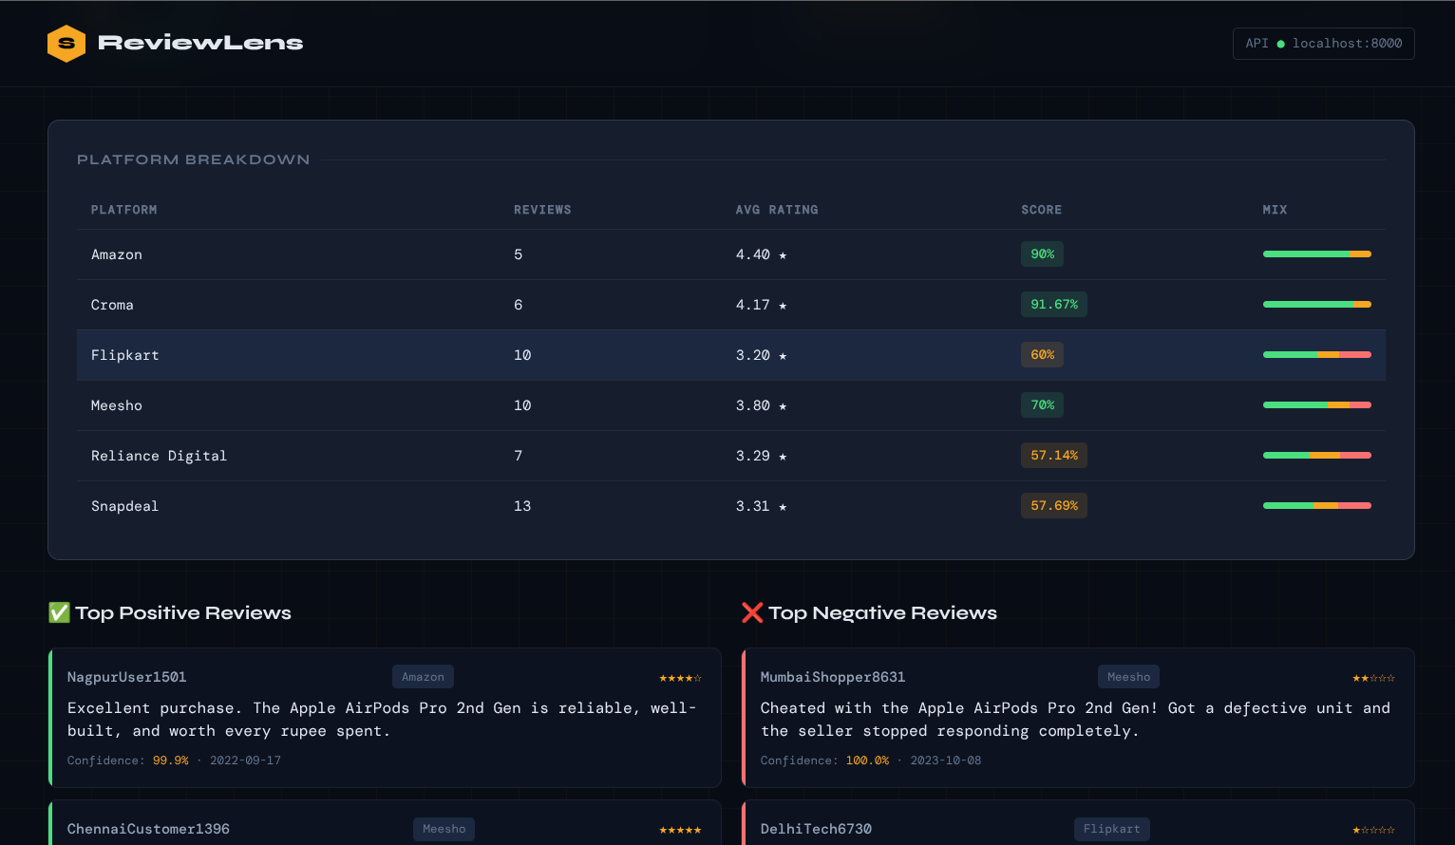
:

Slide 13
Conclusion
It uses sentiment analysis techniques to classify reviews into positive and negative sentiments.
The system identifies the best (most positive) and worst (most negative) reviews for each product and displays it in natural language
It provides a consolidated view of customer opinions instead of requiring users to read reviews from different platforms separately.
Notes:
‹#›

Slide 14
References
Budhwar, J., & Singh, S. (2021). Sentiment Analysis Based Method for Amazon Product Reviews. International Journal of Engineering Research & Technology (IJERT).
Singh, A. K., Singh, A. K., & Thota, S. (2019). Sentiment Analysis for Product Reviews Using Natural Language Processing. International Journal of Advanced Research in Computer Science.
Paul, S., Bhattacharyya, S., Chakraborty, J., & Ray, N. (2025). Sentiment Analysis of Online Shopping Platform Product Reviews. International Journal for Research in Applied Science and Engineering Technology (IJRASET).
Notes:
‹#›

Slide 15
Thank You...!!
Notes:
‹#›

